Slide 1
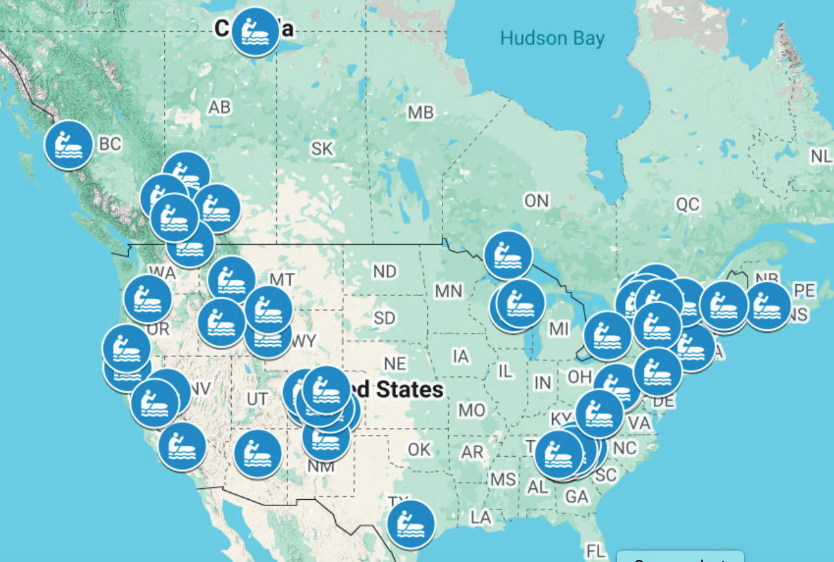
Top 57 Whitewater Towns in the United States and Canda
Introduction
Whitewater kayaking is an exhilarating way to spend your free time. Sometimes it can be hard to find the best places to get out and enjoy the rapids.
This map, and accompanying list, outline the 57 best towns to enjoy your next adventure.
They are based on rankings and reviews from Paddling Magazine and Tripadvisor.
Data
The original data sets were gathered from two main sources:
The Paddling Magazine article 50 Of The Best Whitewater Towns To Visit before You Die.
Tripadvisor 20 Amazing White Water Rafting Trips In The USA.
Attributes including ranking and category are included.
Figure 1: Locations of the 57 top whitewater towns in the United States and Canada. The link to the map can be found here . The link to the data tables can be found here.
Results
Conclusion
There are a total of 57 top rated towns for whitewater in the United States and Canada.
16 of the towns are in Canada. 6 of them are in the province of Ontario and 4 of them are in British Columbia.
The remaining 41 are in the United States. They are mostly spread out along mountain ranges of the west and east coast with the Rocky Mountains being most represented.
In the United States, Colorado leads the pack with 7 entries. California comes in second with 4. The rest are spread out around the United States.
An important factor associated with enjoying your next whitewater adventure is to find the best places to run the rapids.
These two reputable sources have outlined the best towns to take your adventure to the next level.
Enjoy this “best of” list when planning your next whitewater trip.
Citation: Jeremy Johnson(2025), “Top 57 Whitewater Towns in the United States and Canada”. GitHub, https://github.com/jeremybjohnson/GIS-Geocoding
Methods
A table of data was created using the locations for whitewater towns from the two data sources. This table included ranking and category where available
This data was geocoded in Google Maps. The map can be found here 57 Best Whitewater Towns In The United States And Canada.
A file including the latitude and longitude for the locations can be found here.
Author: Jeremy Johnson, Houston City College
GISC 1411 - Geographic Information Systems, Fall 2025

